Slide 1
Conditional Statements and Control Structure
5.1-

Slide 2
Control Structures
Code which alters the flow of a program
Conditionals- run code based on decisions
Loops- repeats code until a condition is met

Slide 3
Conditional statements
If statements – An if statement allows you to run specific blocks of code only if a given condition is true.
Syntax:
if (Boolean Condition)
{
code that you want to run
}

Slide 4
If/else
Allows you to run one block of code if a condition is true and another if a condition is false
Syntax:
if(Boolean Condition)
{
code to run if true
}
else
{
code to run if false
}

Slide 5
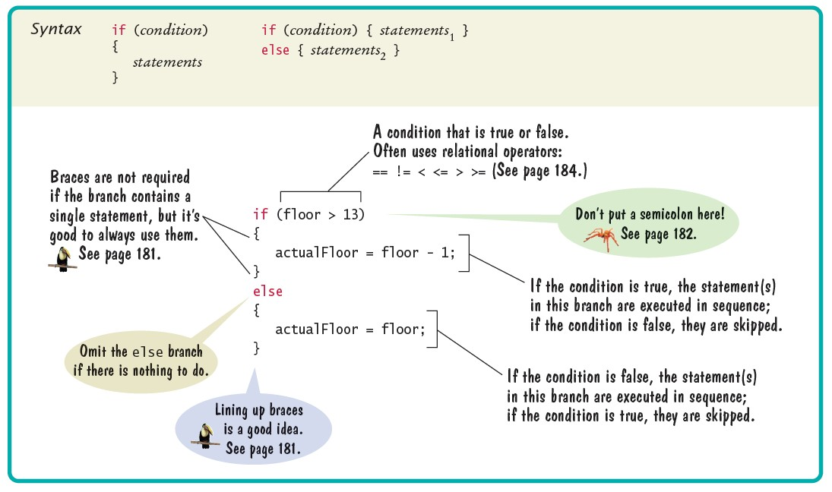

Slide 6
Relational (Conditional) operators
== equal to
!= not equal to
< less than
> greater than
<= less than or equal to
>= greater than or equal to
**You can also use any Boolean variable or method

Slide 7
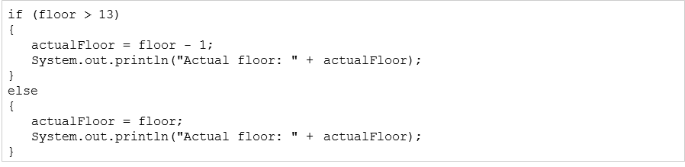
Avoid duplicate Code

Slide 8
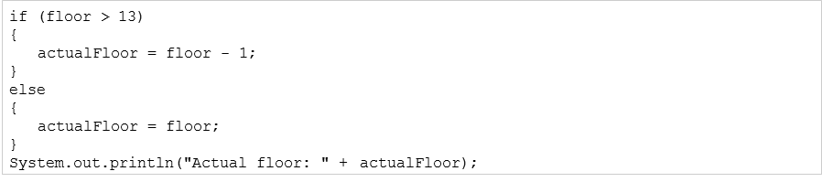
This is better

Slide 9
What will the output be?
String s1 = “Great Valley”;
String s2 = “Great Valley”;
if(s1 == s2)
System.out.print(“same”);
else
System.out.print(“not the same”);

Slide 10
String Comparisons
== operator compares what is stored in the variable.
For strings or any other object that is simply a memory address.
To compare strings use the method .equals(some string)

Slide 11
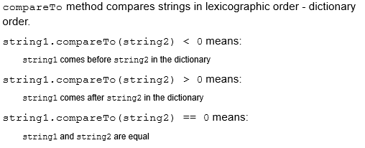
Alphabetical order

Slide 12
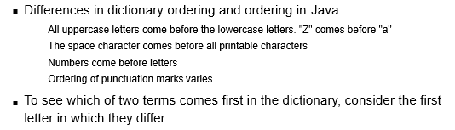
Be careful and pay attention to details

Slide 13
This will work correctly
String s1 = “Great Valley”;
String s2 = “Great Valley”;
if(s1.equals(s2))
System.out.print(“same”);
else
System.out.print(“not the same”);

Slide 14
Multiple Alternatives
Suppose you want to choose from several options.
You can use an else if to check. For example if I want to withdraw money from a bank account, it might look like the following

Slide 15
Scanner in = new Scanner(System.in);
System.out.print(“withdrawal amount: “);
double amt = in.nextDouble();
if (amt < 0)
{
System.out.println(“negative withdraw”);
}
else if (amt > balance)
{
System.out.println(“insufficient funds”);
}
else
{
withdrawal(amt);
}

Slide 16
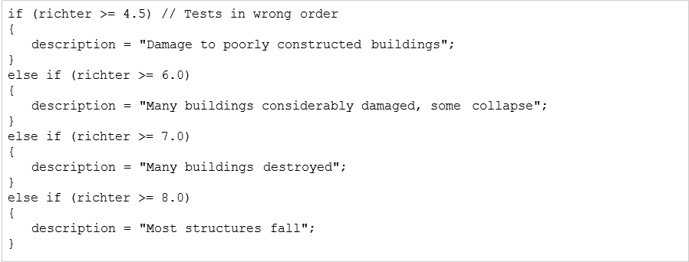

Slide 17
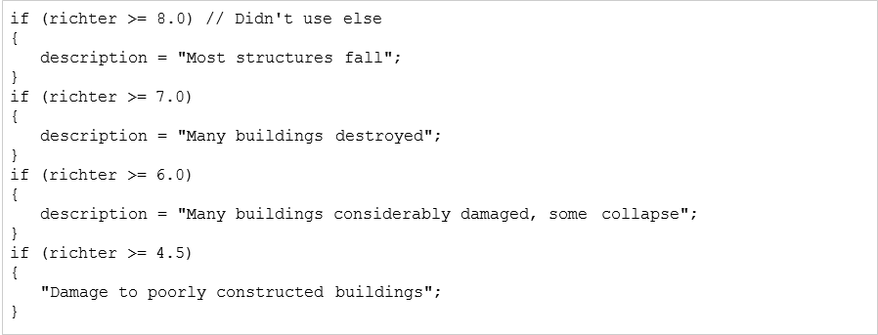

Slide 18
Exercise
I will supply a dice class with a roll method
Review the class, then create a die. Create a Main class which will roll the die 10 times and report how many times each number is rolled.
Print your main class and console and turn in tomorrow

